Slide 1

Eartharxiv: Today and Tomorrow
Tom Narock, Goucher College
Rochelle Taylor, University of Manchester
Evan Goldstein, University of North Carolina at Greensboro,
Arthur Boston, Murray State University
Dasapta Erwin Irawan, Institut Teknologi Bandung
And special thanks to Chris Jackson for valuable discussions!

Slide 2

Preprints
2017
EarthArXiv founded
2020
Moved to the California Digital Library (CDL)
Eartharxiv
A preprint is a version of a scholarly paper that precedes publication in a peer-reviewed journal, typically prior to the formal, journal-led peer review process
Preprints are:
free to submit;
fast to publish;
open access; and
established in many natural sciences
A platform built to host pre/postprints for the Earth and Space Sciences
CDL manages the technical infrastructure
A global community of volunteers handles moderation and governance
We do no peer-review. We moderate for scope/metadata

Slide 3
What does EarthArXiv accept?
Research articles
Review papers
Case studies
Technical notes (e.g. new instrumentation)
Confirmatory studies
So-called ‘null’ results (i.e. results that not
supporting a hypothesis)
Dataset description papers
What does EarthArXiv not accept?
Papers reading as a personal attack, airing of
grievances, or insulting to a group/class of
people. Racist and derogatory language will not
be tolerated
Commentaries and opinion pieces
Posters (cf. ESSOAr)
Theses and course projects (see www.thesiscommons.org)
Software articles
EarthArXiv encourages the publishing of data and software alongside your paper

Slide 4
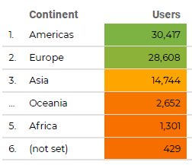
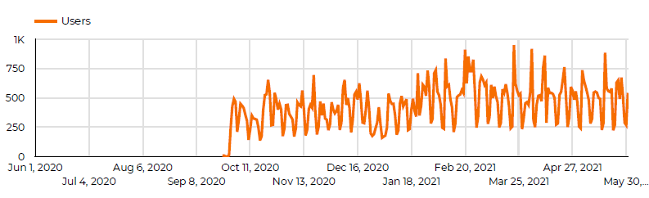
2018
391
2020
684
2019
608
Submissions per Year
Usage Over the Past Year
COS usage not available

Slide 5



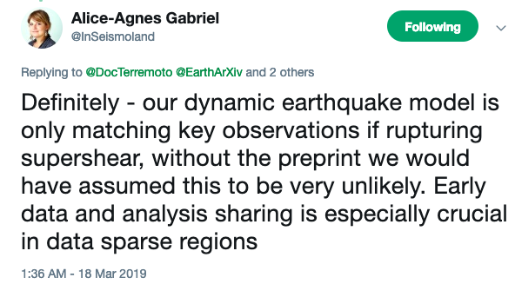
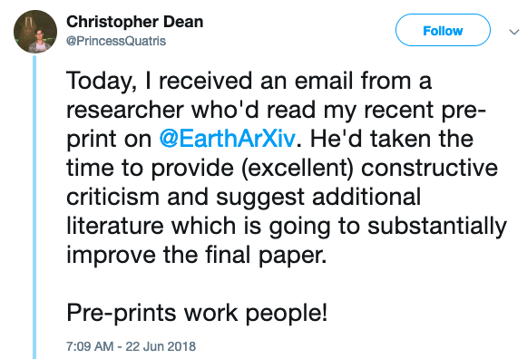
@eartharxiv
Join us, follow us!
Make your work BETTER!
Preprints lead to feedback
& improve your work

Slide 6
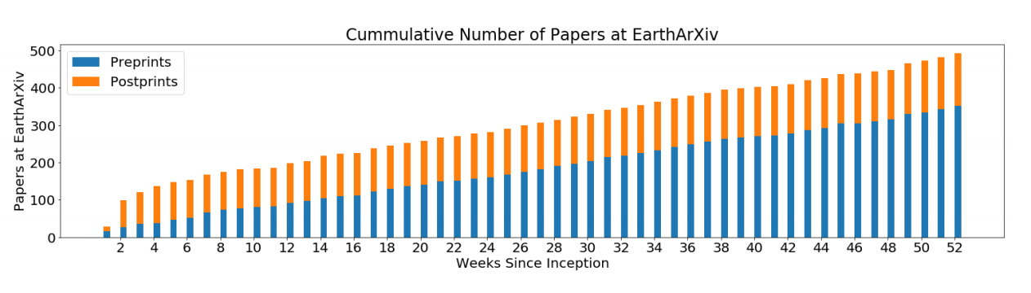
Publishing after EarthArXiv
Initially, EarthArXiv saw more postprints than preprints.
Now, preprints dominate
728 first authors (~30%) returned to EarthArXiv to update preprint info with peer reviewed DOIs
116 of those 728 DOIs (16%) are in Open Access journals of the Directory of Open Access Journals (via UnPaywall API)
598 of those 728 DOIs (82%) are in non-OA journals
84 of those 728 DOIs (12%) did not have complete information via UnPaywall API
Open Question: What drives peer-reviewed publication decisions?

Slide 7
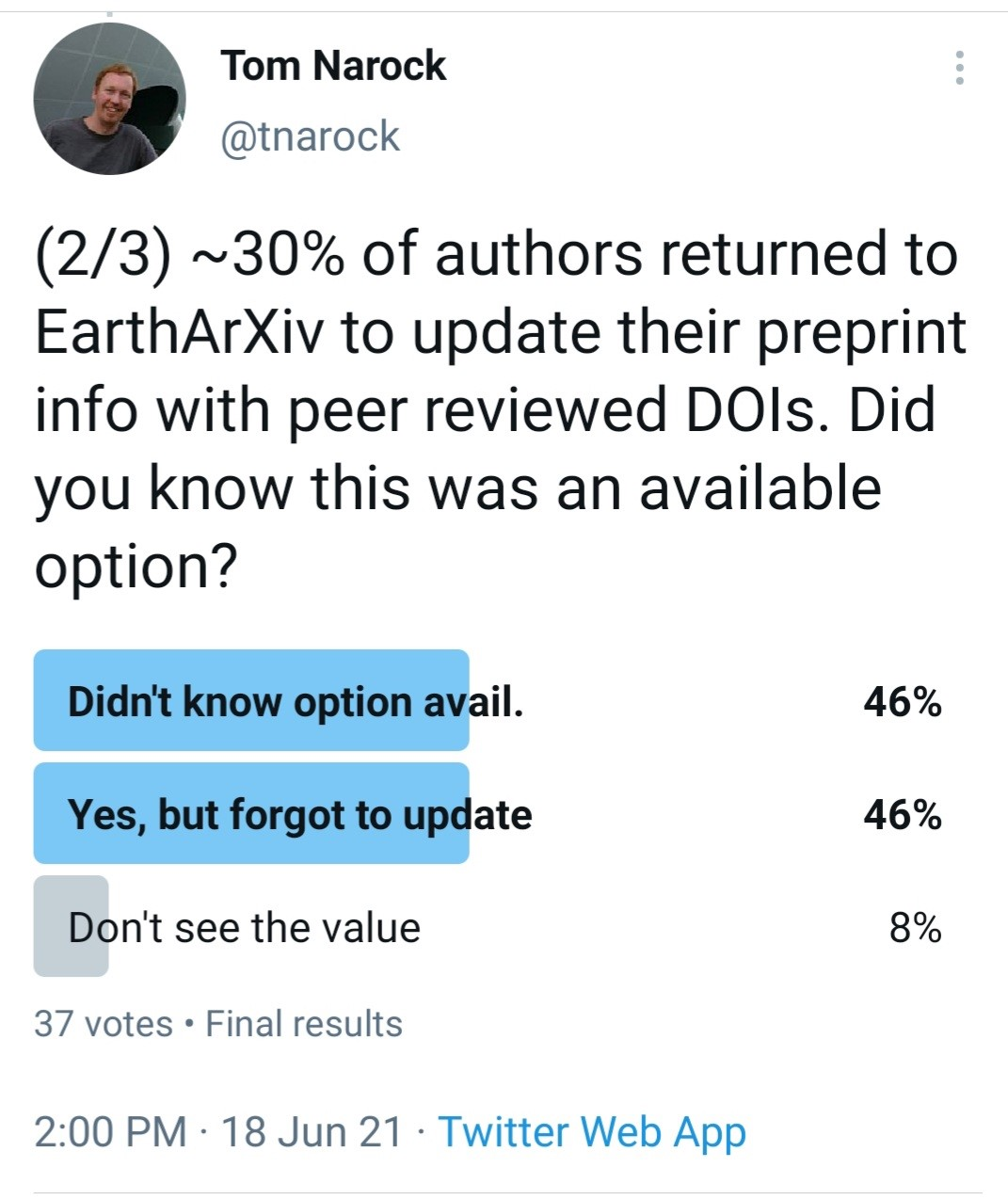


The EarthArXiv of Tomorrow
Outreach to more Earth science disciplines
Better post publication support
Community review and faceted feedback

Slide 8
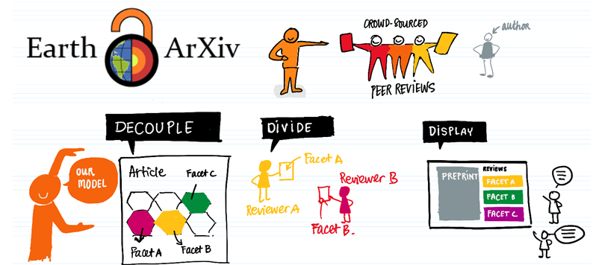
EarthArXiv Could Support…
Decoupled crowdsourced peer-review, e.g. (Boston, 2020, see: zenodo.org/record/4362655)
Connections with journals that enable automated submission (along with reviews)
Amazing artwork by: Dasapta Erwin Irawan

Slide 9

@eartharxiv
Be part of an OPEN community!
http://eartharxiv.org – submit/read preprints
https://eartharxiv.github.io/index.html - community resource repository

